Slide 1
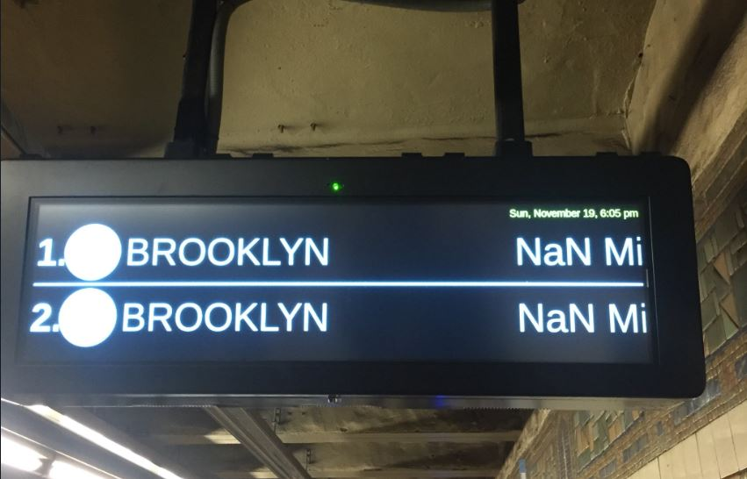
The Stories behind Missing Data: Policy and Practice in Social Services Rika Gorn

Slide 2
Who am I?
@Rika Gorn, R-stats N00b and enthusiast! ☺
10 years working in social service organizations in immigration, mental health, homelessness and housing sectors
Will discuss a few stories behind missing data in social services programs
Why do they exist?
What do they tell us about program design and outcomes?
How do we use policy, operational, and R solutions to improve services for vulnerable and underserved communities?

Slide 3
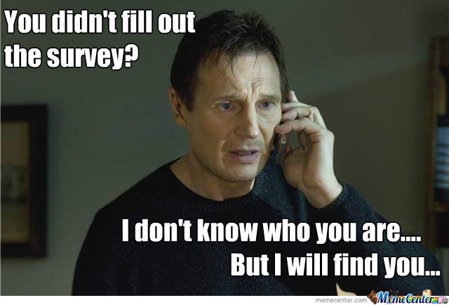
Reasons for Missing Data
Not engaged audience
Poor data collection tools
Lack of organizational/technical infrastructure
Poor data quality
Challenges in data sharing/collaborating
Self-censorship or self-preservation
Lack of trust
Dependent on other variables – MAR vs. MCAR vs. MNAR

Slide 4
Example 1: Where did the time go?
Program serving adults with series mental illness transitioning from the State Psychiatric hospital back to the community.
Goal to reduce hospital readmissions, shorten length of stays, and reduce emergency department use.
Clients show up in multiple hospitals at the same time and day!!
Policy | Organizational/Infrastructure | Analytical
Never underestimate the breadth of the network and lack of communication between players Does the program model need a change? (e.g. Housing First) What are the implications of security and privacy on the program? (e.g. HIPAA) | Train staff on data entry in EHR Determine if staff have the right tools Case management vs. data entry in EHR Diagnose staff turnover, motivation, and burnout | Provide clarity on “definitions” for variables Use R package for imputing values for univariate time series: ImputeTS, Amelia
Result: Were able to determine that most hospital re-admissions occurred within the first 30 days of initial community entry

Slide 5
Example 2: Sharing Dangerous Information
Program working to house and protect vulnerable youth across 3 countries
Enormous amounts of missing data on where youth go after program
Policy | Organizational/Infrastructure | Analytical
Determine if different outcomes are desired by network players or organizations Understand relationships between civic actors and government agencies | Minimize mandatory collection of data that can jeopardize the safety of your clients Provide safety and privacy precautions across multiple time junctions during your program Understand your audience Board members vs. Program staff | Create new variables (e.g. “Refused to Answer”, Don’t Know vs. Missing) Forcats::fct_collapse::fct_lump Visualize missing data using VIM, visdat, ggplot2, naniar
Result: Outcome metrics revised to account for cultural and sector context

Slide 6




Thanks R-Ladies NYC!
@RikaGorn
Rikagx@gmail.com
@RikaGorn
(mostly pictures of my dog Zoe!)

